Slide 1
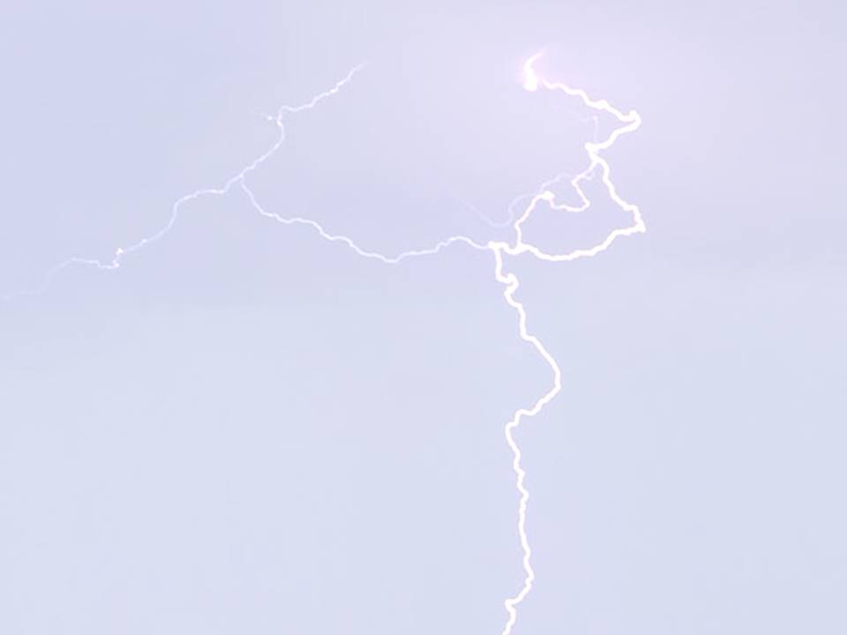
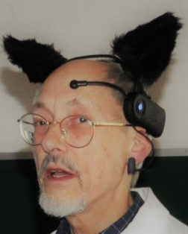

Electroacupuncture (EA) and the EEG:
An unfinished personal journey, 2001-2022. From simple hypothesis to artificial intelligence (AI)
David Mayor
MA, BAc, Hon member AACP,
Visiting Fellow, School of Health and Social Work,
University of Hertfordshire, UK
http://electroacupuncture.qeeg.co.uk/
davidmayor@welwynacupuncture.co.uk
AACP Virtual Conference
21 May 2022

Slide 2
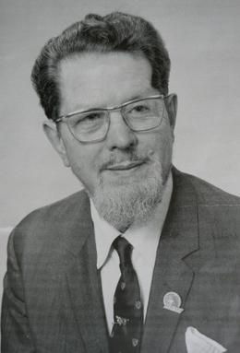
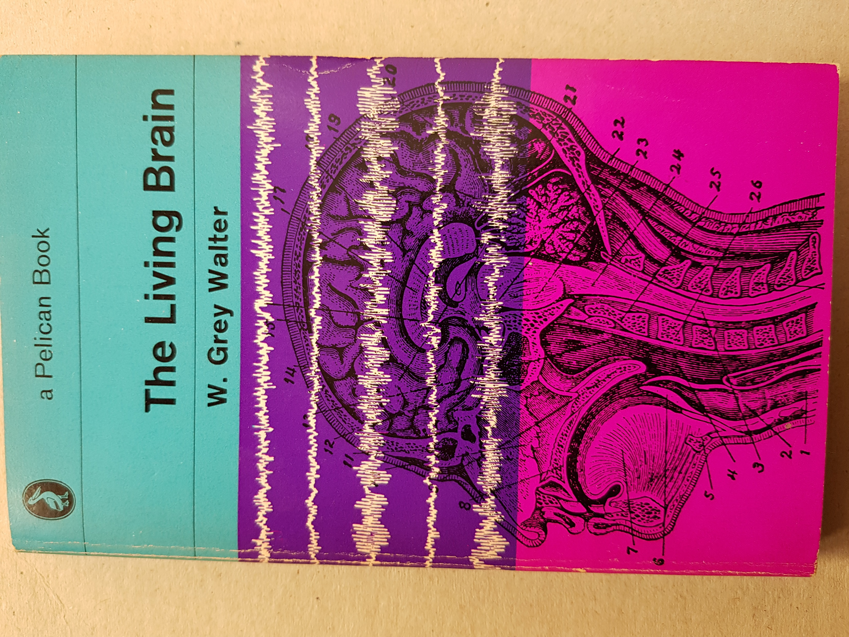
William Grey Walter and his book
“The deeper we seek, the more is our wonder excited”
(Abdus Salam)

Slide 3
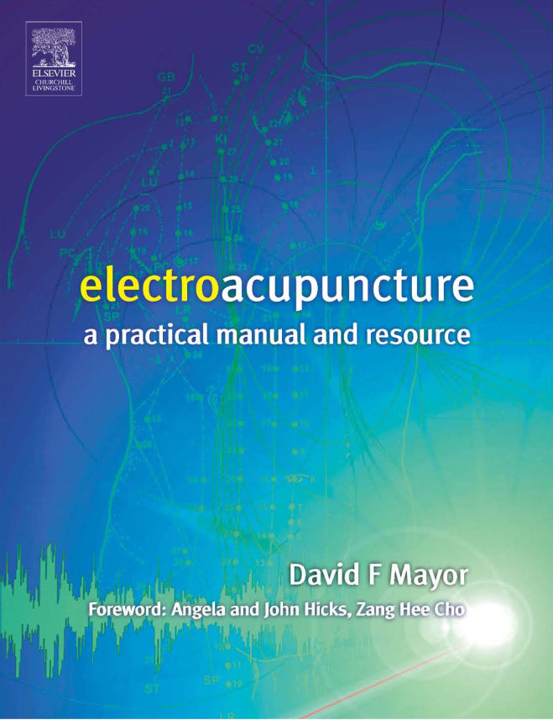
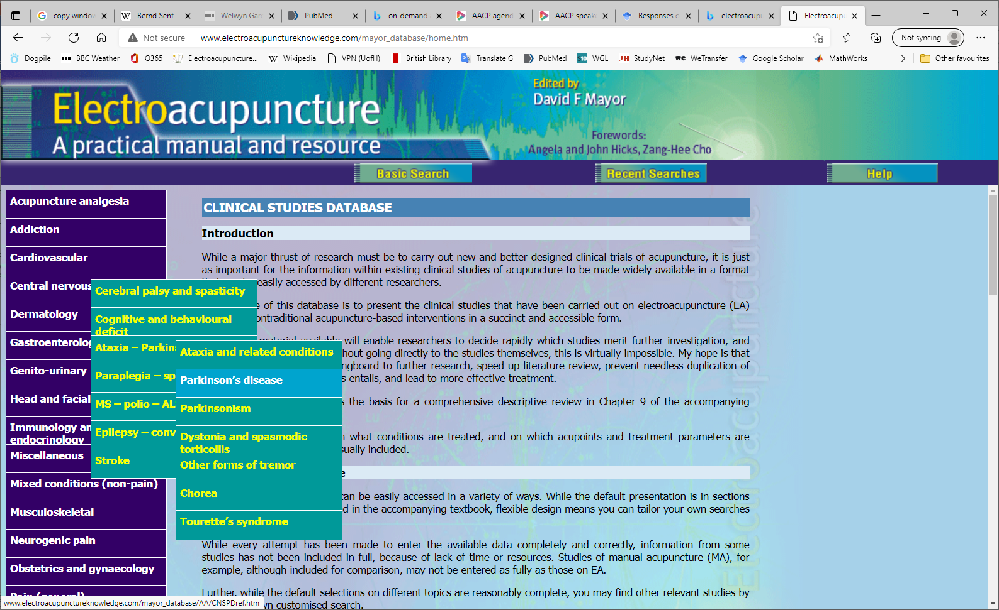
Electroacupuncture book and website

Slide 4
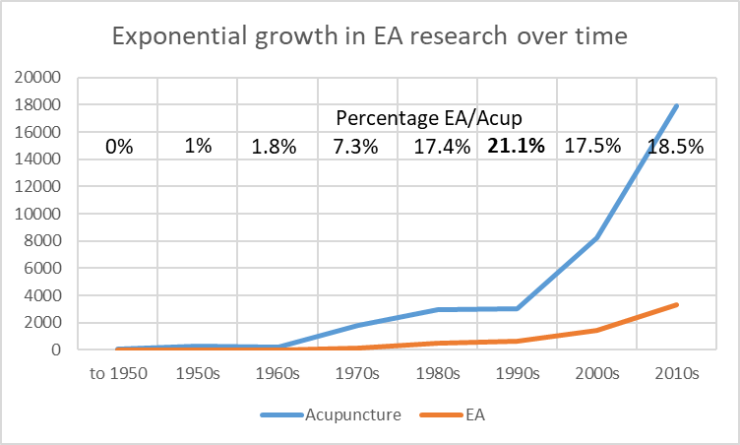
Timeline of EA research (from PubMed)

Slide 5
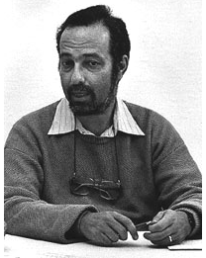
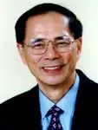
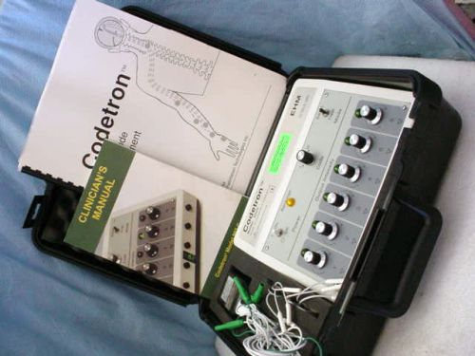
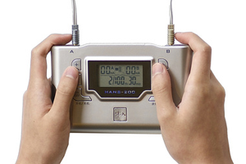
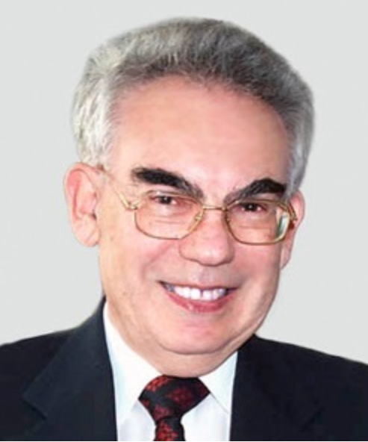
Electroacupuncture/TEAS – the brain and frequency
Han Jisheng & the HANS
stimulator
Bruce Pomeranz, Norman Salansky and the CODETRON

Slide 6
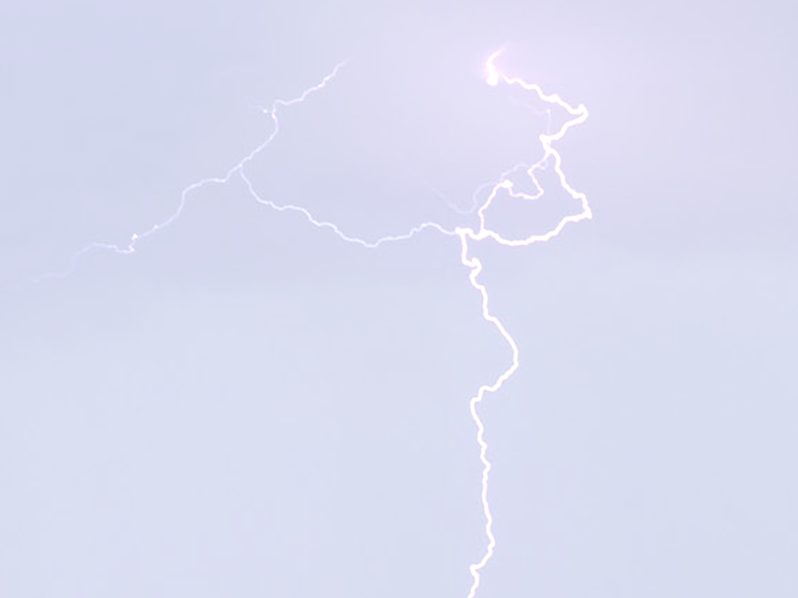
EA neurophysiology – a summary from the 1990s
6
6

Slide 7
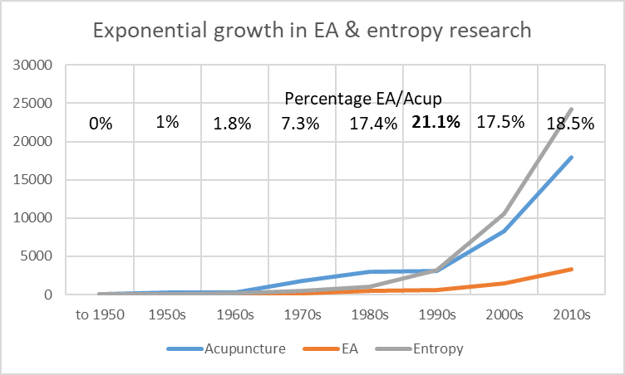
Timeline of EA & entropy research (from PubMed)

Slide 8
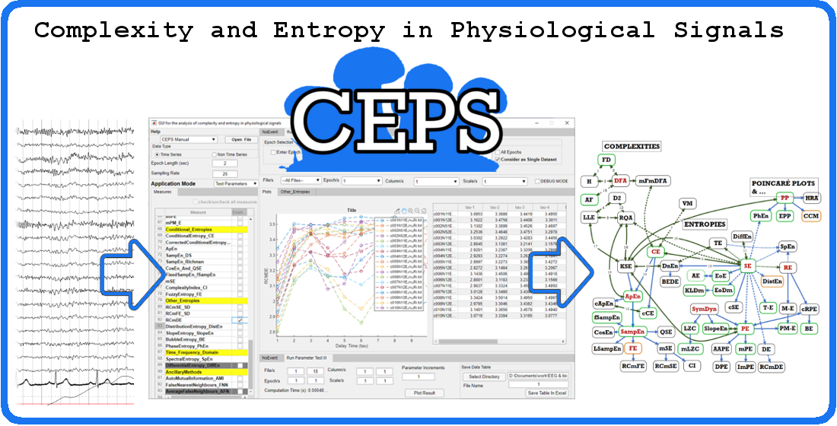
Visual abstract by Tony Steffert (https://doi.org/10.3390/e23030321)

Slide 9
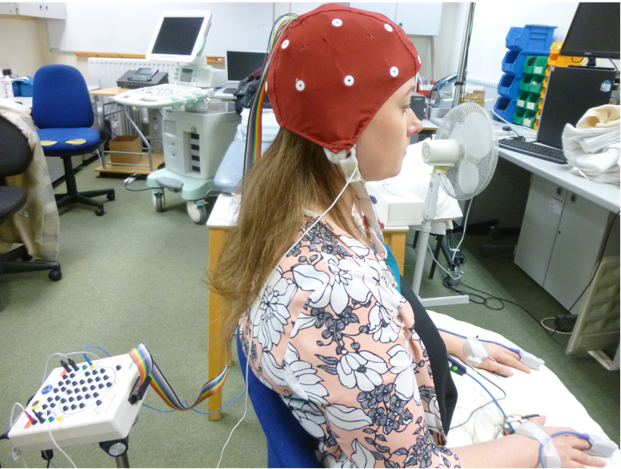
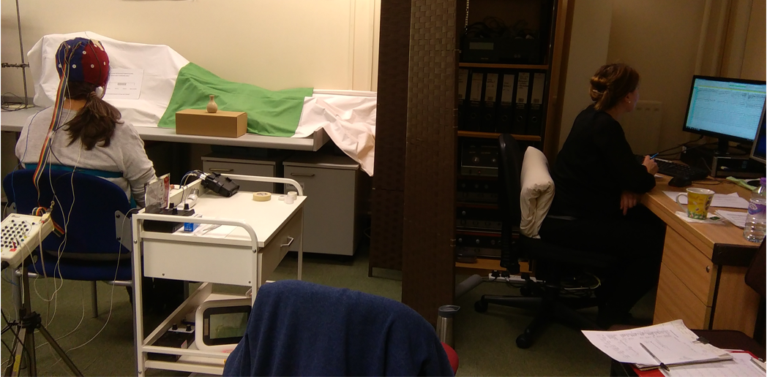
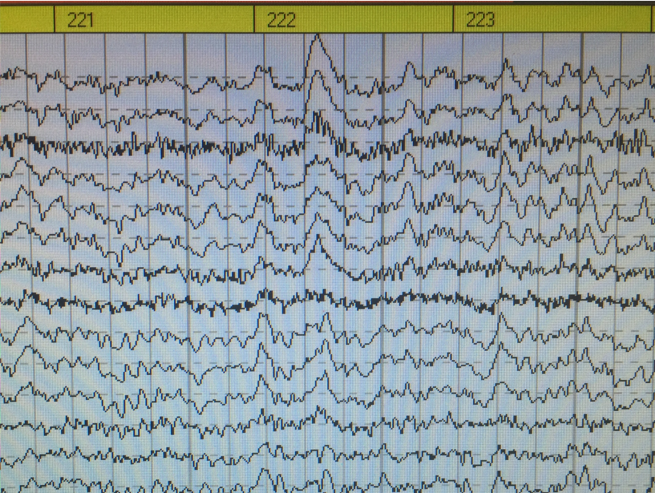
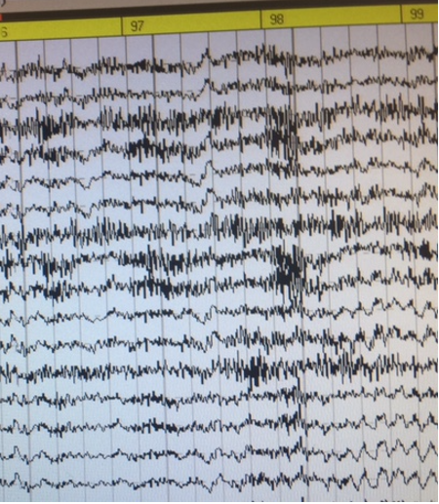
Collecting data in the Physiotherapy Lab
Above: Participant with cap and Mitsar amplifier, eyes open, looking at an object to reduce eye movement.
Researcher, hidden from view, observes onscreen EEG.
Left: 19-channel EEG data with blink & muscle activity.
Right: EEG showing the effect of jaw clenching.

Slide 10
Online initial questionnaire
Online initial questionnaire
Session – time line
8 x 5-minute slots
Baseline | Stim1 | Stim2 | Stim3 | Stim4 | Post1 | Post2 | Post3
Physiological monitoring (EEG, ECG, PPG, Respiration, Head movement)
Room temp
Room temp
Room temp
Room temp
Online debriefing questionnaire

Slide 11
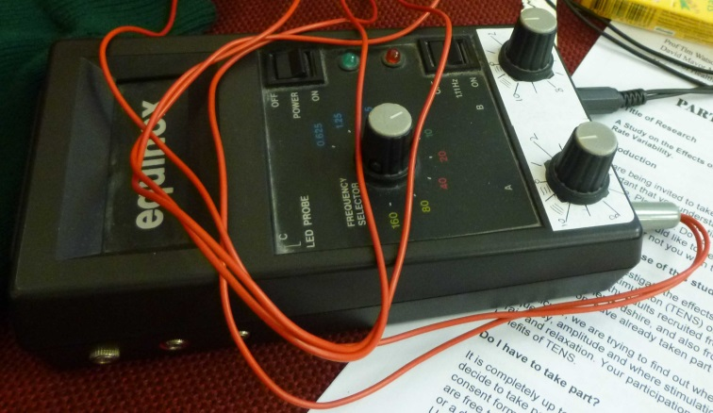
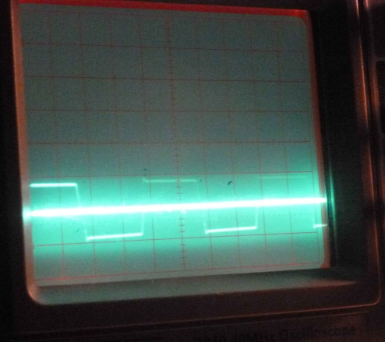
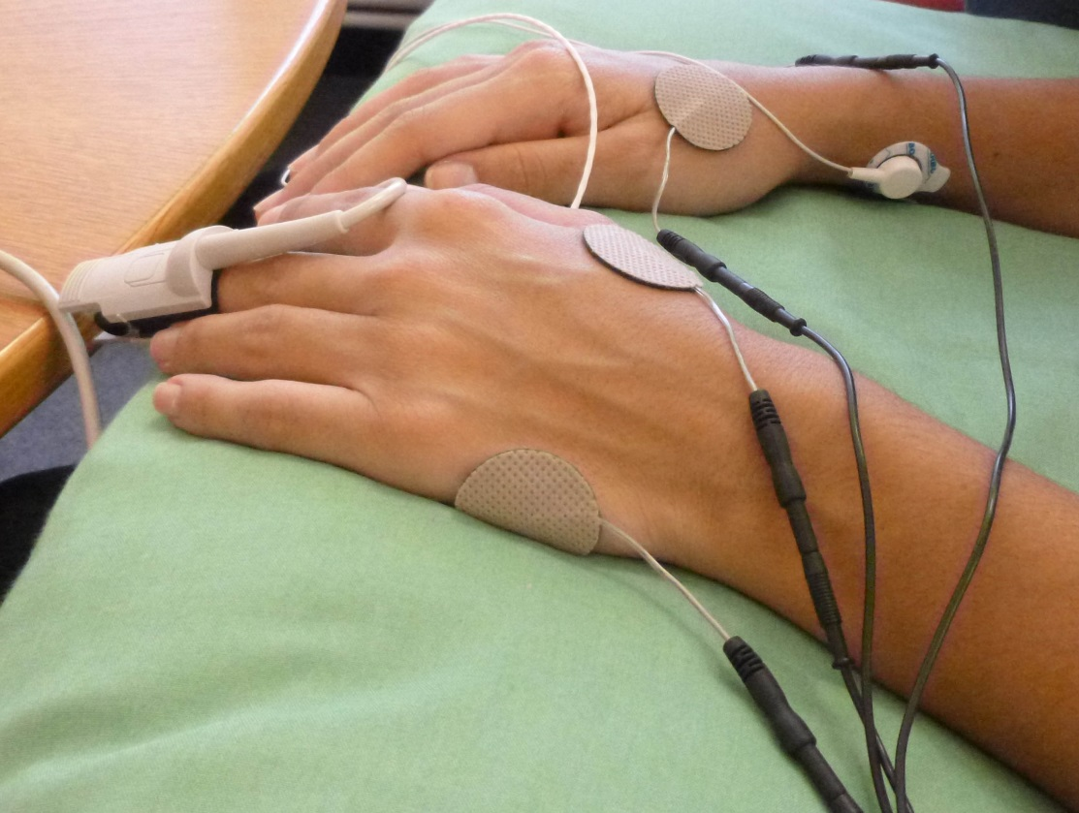
TEAS – Stimulation details
Above: The Equinox stimulator and its output.
Below: Sensors and electrodes in place, showing fingertip PPG sensor, one ECG electrode on right forearm, and TENS electrodes at LI4 and on the ulnar border of the hands. ECG electrodes on the left forearm are not visible (thermistor on left middle finger is hidden by the PPG sensor).
Note: True square waves are made up of odd ‘harmonics’.
A 2.5 Hz square wave is the sum of sine waves at 2.5 Hz (the ‘fundamental’) and its
odd ‘harmonics’ - 7.5 Hz,
12.5 Hz, 17.5 Hz … etc.

Slide 12
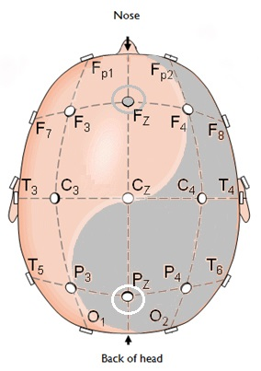

Electrical activity in the brain. I. EEG electrodes
The ‘10-20’ system
Fp Prefrontal
Left Yang (odd)
F Frontal
C Central
T Temporal
Right Yin (even)
P Parietal
O Occipital
We used these 19 electrodes, recording with the linked ears
potential as ‘reference’ (zero).
Some systems use 64, 128 or more electrodes.
12

Slide 13

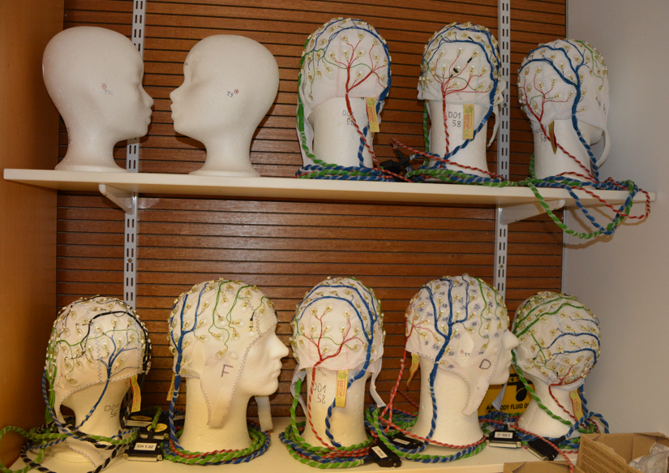
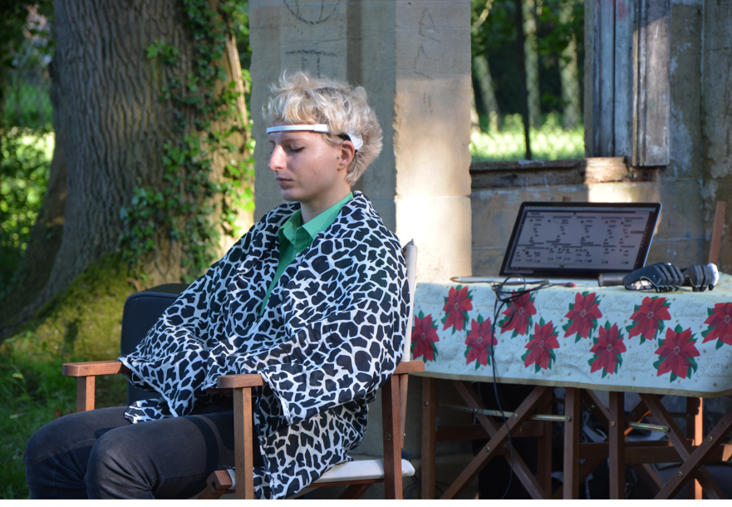
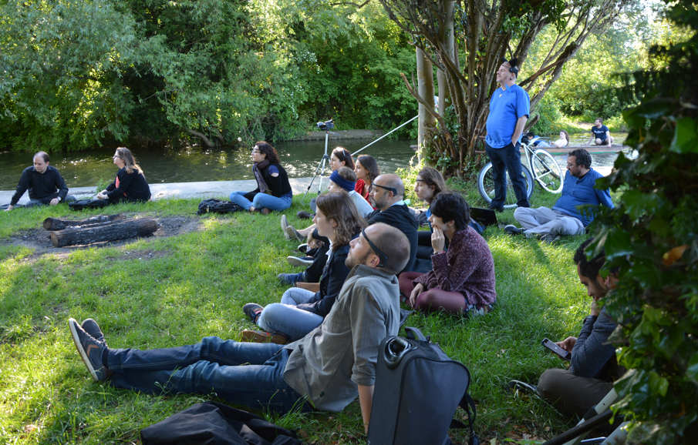
EEG caps at the MRC
‘Conductor’ and ‘orchestra’, wearing Muse headbands on the banks of the Cam

Slide 14
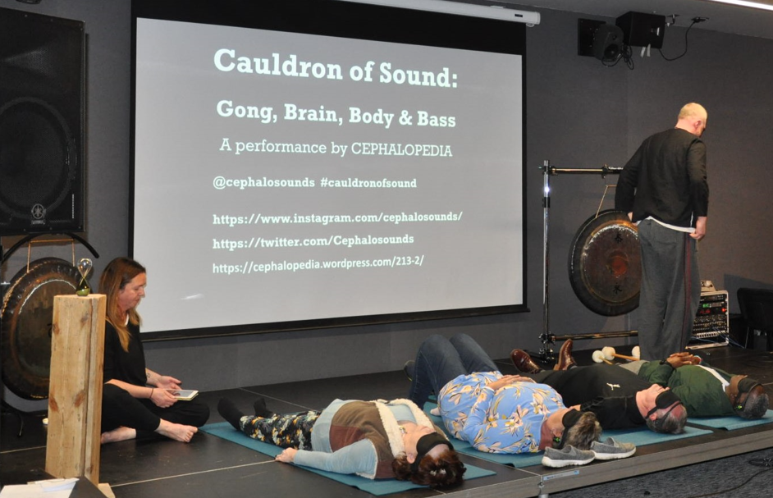
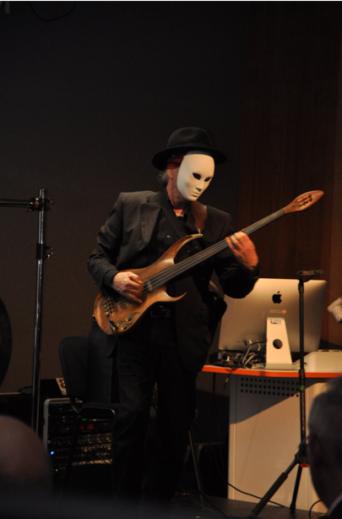
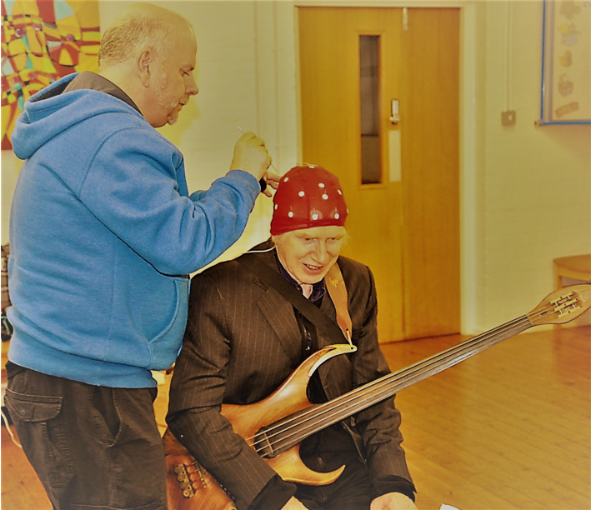
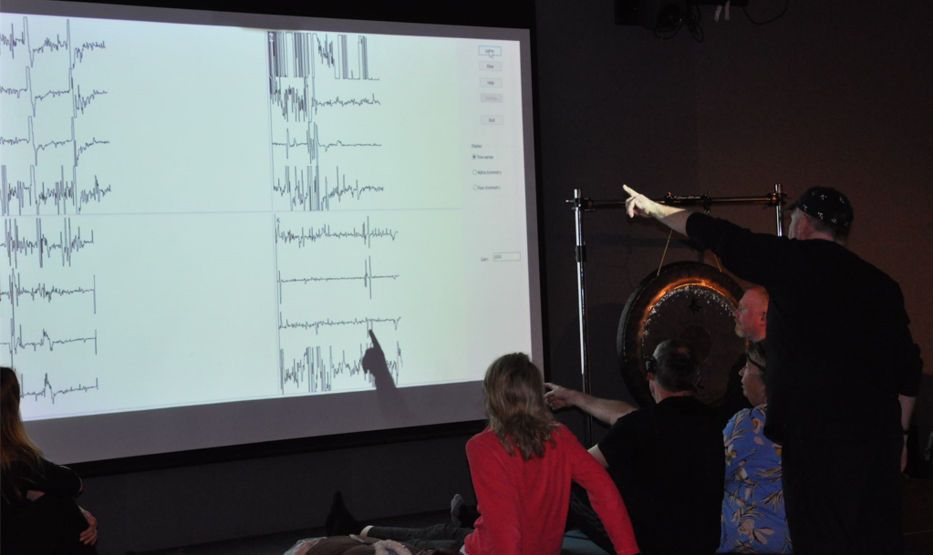
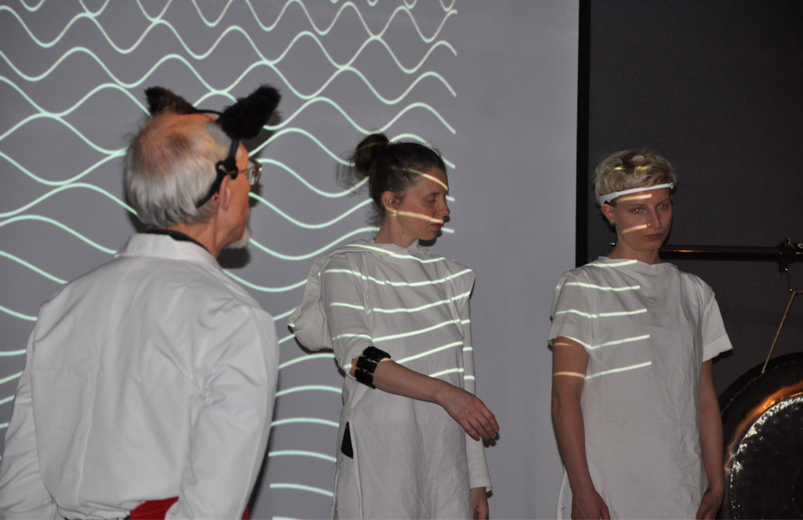
‘Capping up’
Sensors
Tony Explaining

Slide 15
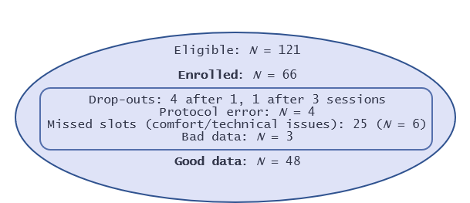
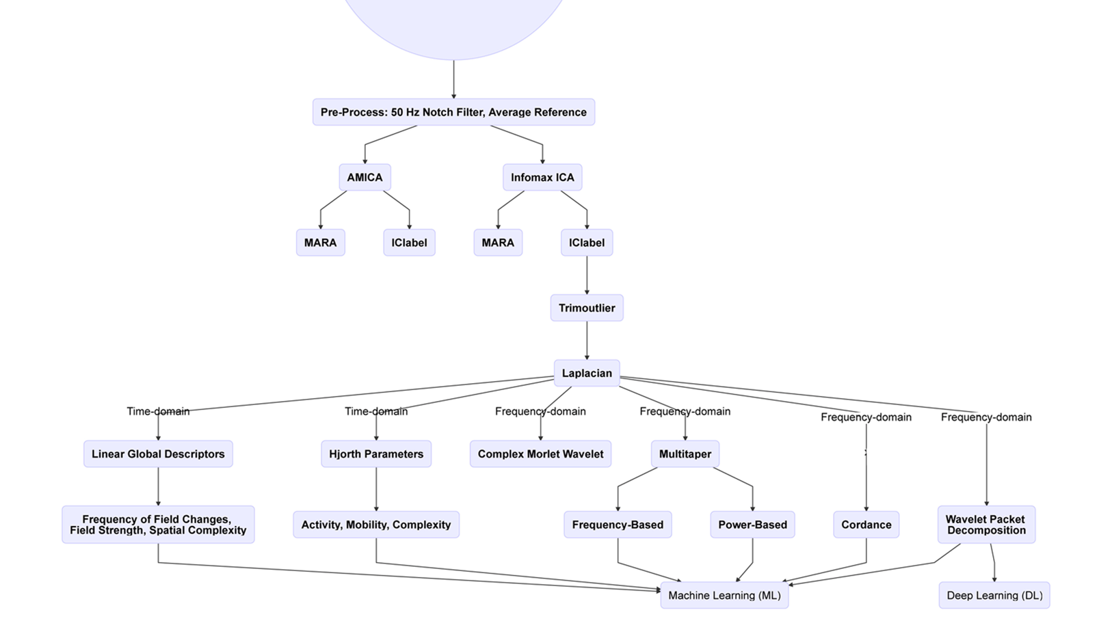
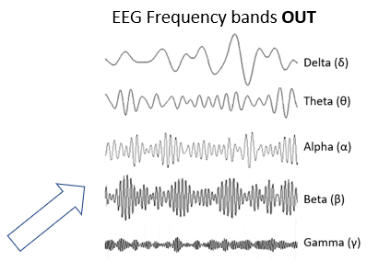
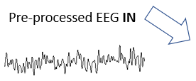

Slide 16
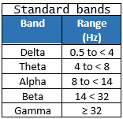
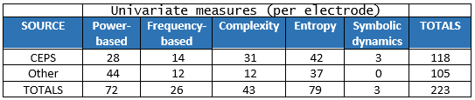
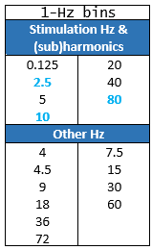
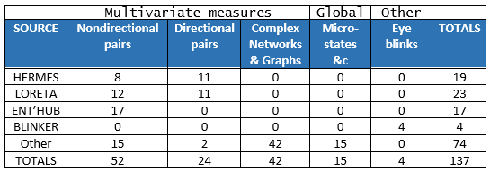
EEG bands and potentially useful measures
Band | Frequency (Hz)
Delta | 0.5 to < 4 Hz
Theta | 4 to < 8 Hz
Alpha | 8 to < 14 Hz
Beta | 14 to 31 Hz
Gamma | ≥ 32 Hz
HERMES, LORETA, Entropyhub and BLINKER are computational toolboxes used in EEG analysis. Numbers in the lower Table are approximate.

Slide 17
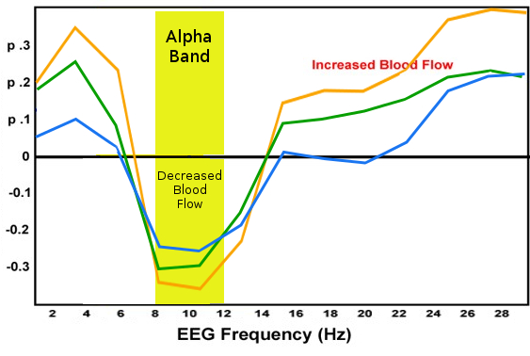
EEG ‘cordance’
Partial correlations between perfusion and EEG cordance or power
Research by Leuchter et al. suggests
that blood perfusion within the brain
(motor strip) during a hand motor task is inversely correlated with alpha power or cordance (with eyes open or closed).
Others have found that blood perfusion correlates negatively with resting delta, not alpha power (O’Gorman et al. 2012).
We know EA improves blood flow.
Will different frequencies of TEAS have different effects?
p-values
Z-normalised cordance
Relative power
Absolute power
Adapted by Tony Steffert from Leuchter et al. 1999

Slide 18
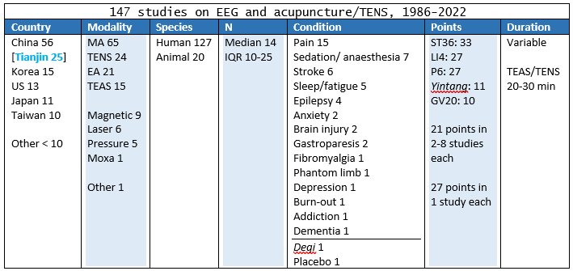
Literature review 1
Abbreviations:
EA: Electroacupuncture; IQR: Interquartile range;
TEAS: Transcutaneous electroacupuncture stimulation; TENS: Transcutaneous electrical nerve stimulation.

Slide 19
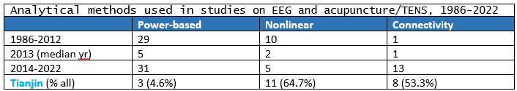
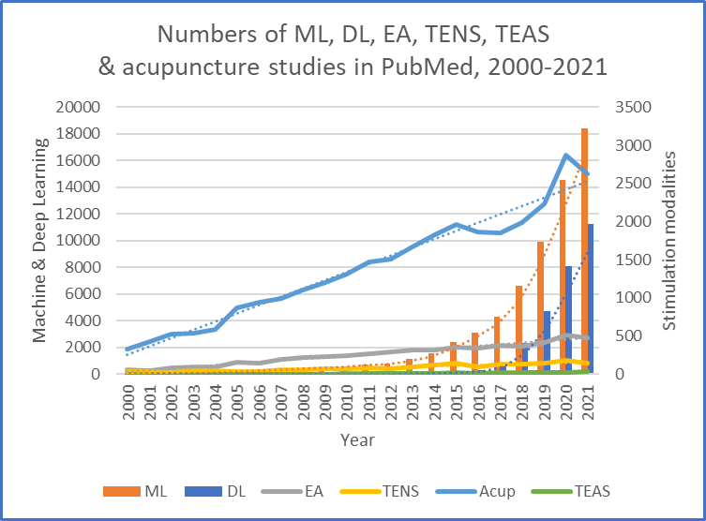
Literature review 2
Abbreviations:
DL: Deep learning
ML: Machine learning.
Dotted lines indicate trends –
linear or exponential.

Slide 20
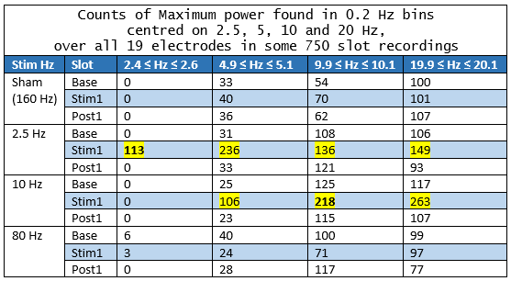
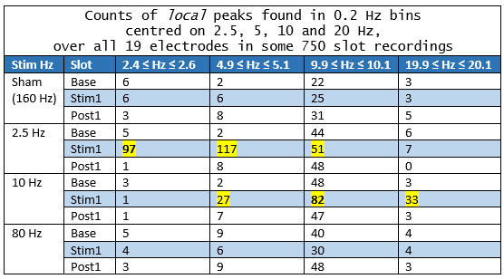
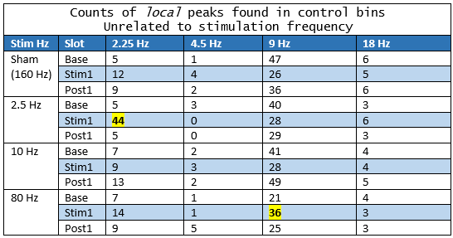
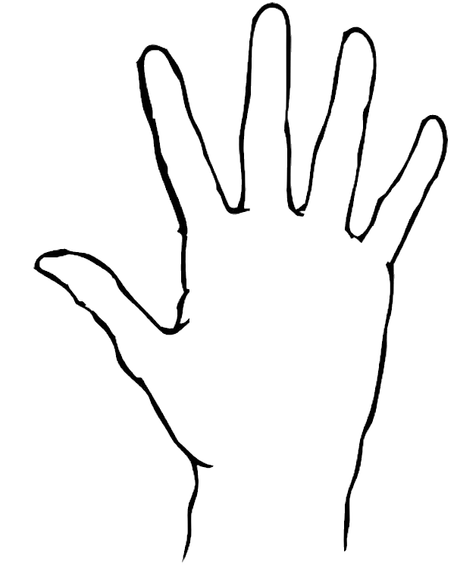
Some recent study results 1. Counts of peaks & powers
Note the predominance of alpha (9-10 Hz) in both Tables of peaks, but not the Table of Maximum powers.
RH
LH

Slide 21
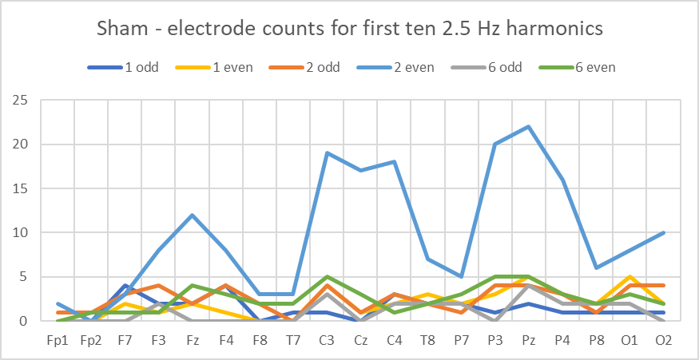
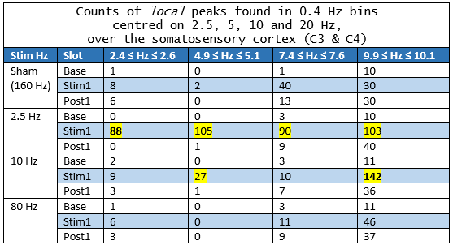
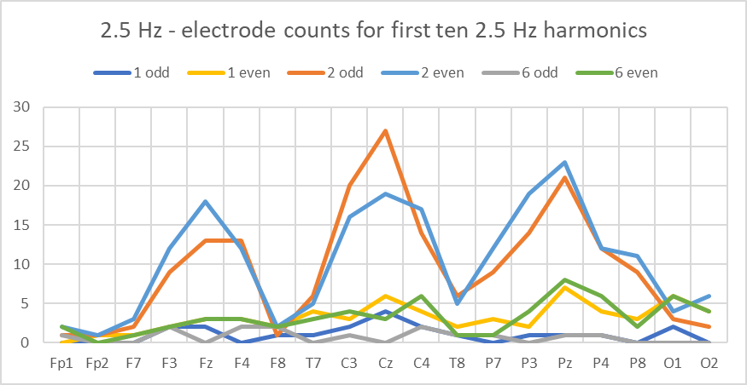


Some recent study results 2. The somatosensory cortex
More even than odd harmonics of 2.5 Hz occur at C3 and C4 during Sham and 10 Hz TEAS,
but this is less clear at 2.5 Hz,
and the effect collapses at 80 Hz.
Note that the effect does not continue after TEAS.
What does this tell us about FFR vs VC?
FFR 1, VC 1

Slide 22


EEG regions 1. Anterior (A) & posterior (P)
A
P
N peaks
During
TEAS

Slide 23


EEG regions 2. Left (L) & right (R)
L
R
N peaks
During
TEAS

Slide 24


EEG regions 3. Central (C) and outer (O)
During 2.5 Hz stimulation,
more peaks occur at the central electrodes
(p < 10⁻⁶) .
During 10 Hz stimulation,
similar numbers of peaks occur centrally and at the outer electrodes (n.s.).
During Sham and 80 Hz stimulation,
more peaks occur at the outer electrodes
(p < 10⁻⁶, p = 0.004).
C
O
N peaks
During
TEAS

Slide 25


EEG regions 4. All and harmonic peaks
Peaks – especially harmonic peaks – occur more often
during TEAS on the Left (but not at 10 Hz), Posteriorly
and Centrally (at 2.5 Hz).
FFR 2, VC 2

Slide 26






Local peaks – before, during and after TEAS
CV = 0.173
Total Counts

Slide 27






Cordance: a work-in-progress 1
Inset: with Delta removed
Alpha cordance decreases at all frequencies except 2.5 Hz.
Slopes:
Sham -5.9
2.5 Hz +2.5
10 Hz -13.4
80 Hz -4.1
Does this tell us anything about blood perfusion?
Slots
Slots
Slots
Slots

Slide 28


Cordance: a work-in-progress 2
Slots
Slots
Left: Differences in cordance with frequency are fewer post-TEAS.
Right: At some electrodes, these differences are more evident in 1-Hz bins than standard bands.
Significant differences in cordance with frequency occur more often on the Left and Anteriorly than
on the Right or Posteriorly (p < 10⁻², p < 10⁻⁴).
During stimulation, posterior/anterior, left/right and central /outer ratios of positive cordance (‘concordance’) are all greatest during sham TEAS.
FFR 3, VC 2?

Slide 29




EEG linear time-domain measures
Is 10 Hz TEAS ‘different’
in some way.
If so – what does this
tell us?
Slots
Slots
Slots
Slots

Slide 30


Deep Learning vs Machine Learning 1
Abbreviations:
ANN = Artificial Neural Network; CNN = Convolutional Neural Network; (F)LDA = (Functional) Linear Discriminant Analysis; k-NN = k-Nearest Neighbours algorithm; LSTM = Long Short-Term Memory; MLP = Multi-Layer Perceptron; NB = Naïve Bayes; SVM = Support Vector Machine.

Slide 31

Deep Learning vs Machine Learning 2
Splitting data into subsets for training and evaluation may introduce artefacts that are exploited by the classifier
Training dataset size, confounding clinical variables, and variability in data collection and interpretation may affect generalisability of all methods. Regularisation or data augmentation may improve model generalisability in both DL and ML
Increased complexity may not improve accuracy!
[References to these Tables available on request]

Slide 32
Cast, in order of appearance (Acknowledgements)
[In bold, major contributors to this project. Country codes indicate nationality/residence]
Abdus Salam (PK) Tim Watson (AU/UK) Çağlar Uyulan (TR)
William Grey Walter (US/UK) Evgenia Emets (RU/PT) Iosif Mporas (GR/UK)
Bernd Senf (DE) Tony Steffert (NZ/UK) Stavros Dimitriadis (GR/UK)
Ioan Florin Dumitrescu (RO) Ronakben Bhavsar (IN/UK) Davide Faranda (FR)
Mike Weaver (UK) Na Helian (CN/UK)
Roger Hill (UK) Deepak Panday (NP/UK) My wife and family
Gordon Gadsby (UK) Harikala Kandel (NP/UK)
Mike Flowerdew (UK) Aistė Noreikaitė (LT)
Rodney Robinson (UK) Lidia Zaleczna (PL/UK)
Norman Salansky (RU/CA) Thea Radüntz (DE)
Angela Hicks (UK) Paul Steinfath (DE)
John Hicks (CA/UK) Neil Spencer (UK)
Zang-Hee Cho (KR/US) Ciarán Beggan (UK)
Stephen Lee (UK) Andrew Leuchter (US)
Lynn Pearce (UK) Türker Tekin Ergüzel (TR)
Kevin Young (UK) Bo Hjorth (SE)
Han Jisheng (CN) Firgan Feradov (BG)
Bruce Pomeranz (CA) Jiří Wackermann (CZ/DE)
CEPS Contributors
Pedro Bernaola-Galván (ES)
Paolo Castiglioni (IT)
David Cornforth (AU)
David Cuesta-Frau (ES)
Harold (Dusty) Dowse (US)
Luis Estrada (ES)
Jean-Marc Girault (FR)
Chang Francis Hsu (TW)
Anne Humeau-Heurtier (FR)
Zhiqiang Huo (CN/UK)
Antonio Ibáñez-Molina (ES)
Chandan Karmakar (IN/AU)
Peng Li (CN/US)
Alireza Mani (IR/UK)
George Manis (GR)
Pasquale Nardone (IT/BE)
Ashish Rohila (IN)
Giuseppe Sanfilippo (IT)
Carlos Sevcik (VE/ES)
Chang Yan (CN)
Luciano Zunino (AR)
& co-author Duncan Banks (UK)

Slide 33
Sources 1
Slide 2
Fraser G. 2008. Cosmic Anger: Abdus Salam - The first Muslim Nobel scientist. Oxford: Oxford University Press.
Salam A. Banquet speech, Nobel Prize in Physics 1979. Stockholm, 10 December 1979.
https://www.nobelprize.org/prizes/physics/1979/salam/speech/ [accessed 2 February 2022].
Walter WG. 1961. The Living Brain. Harmondsworth: Penguin Books.
Senf B. Wilhelm Reich: Discoverer of acupuncture energy. American Journal of Acupuncture. 1979;7(2):109-118.
Dumitrescu IF et al. Dr. Ioan Florin Dumitrescu Homage Page. http://ioanflorindumitrescumd.com/ [accessed 12 January 2022].
Salansky N, Fedotchev A, Bondar A. Responses of the nervous system to low frequency stimulation and EEG rhythms: Clinical implications. Neuroscience & Biobehavioral Reviews. 1998;22(3):395-409.
Slide 3
Mayor DF. (Ed.) 2007. Electroacupuncture: A practical manual and resource. Edinburgh: Elsevier Churchill Livingstone.
Slide 6
Han JS et al. 2022. Dr. Ji-Sheng Han. Han Institute website. https://www.han-institute.com/founders/dr-ji-sheng-han/ [accessed 12 January 2022].
Walter VJ, Grey Walter W. The central effects of rhythmic sensory stimulation. Electroencephalography and Clinical Neurophysiology. 1949; 1(1): 57-86.
Cho ZH, Chung SC, Jones JP et al. New findings of the correlation between acupoints and corresponding brain cortices using functional MRI. Proceedings of the National Academy of Sciences, USA. 1998;95(5):2670-2673.
Mayor DF. CNS resonances to peripheral stimulation: Is frequency important? Journal of the AACP. 2001:29-63.
Bhavsar R, Helian N, Sun Y. Davey N, Mayor D, Steffert T. The Effects of electro-acupuncture related methods on the EEG signals. Poster presentation, 17th International Acupuncture Research Symposium, King’s College London, 21 March 2015.
Mayor D, Steffert T, Bhavsar R. Changes in finger temperature and blood flow in response to different frequencies of transcutaneous electroacupuncture at LI4 (hegu). Interim analysis and ‘real life’ methodological issues: many factors, missing data and a multiplicity of measures. Poster presentation, 17th International Acupuncture Research Symposium, King’s College London, 21 March 2015.
Slides 8 & 14
Mayor D, Panday D, Kandel HK, Steffert T, Banks D. CEPS: An open access MATLAB Graphical User Interface (GUI) for the analysis of Complexity and Entropy in Physiological Signals. Entropy. 2021;23(3):321.
Slide 11
Square Wave. Wikipedia. https://en.wikipedia.org/wiki/Square_wave [accessed 7 February 2022].
Slide 13
Tadel F, Baillet S, Mosher JC et al. Brainstorm: A user-friendly application for MEG/EEG analysis. Computational Intelligence and Neuroscience. 2011;2011:879716.
Slide 14
Radüntz T, Scouten J, Hochmuth O et al. Automated EEG artifact elimination by applying machine learning algorithms to ICA-based features. Journal of Neural Engineering. 2017;14(4):046004
Cephalopedia. https://www.facebook.com/cephalosounds/.

Slide 34
Sources 2
Slide 17
Leuchter AF, Cook IA, Mena I et al.. Assessment of cerebral perfusion using quantitative EEG cordance. Psychiatry Research. 1994;55(3):141-152.
Leuchter AF, Uijtdehaage SH, Cook IA et al. Relationship between brain electrical activity and cortical perfusion in normal subjects. Psychiatry Research Neuroimaging. 1999;90(2):125-140.
O’Gorman RL, Poil SS, Brandeis D et al. Coupling between resting cerebral perfusion and EEG. Brain Topography. 2013;26(3):442-457.
Slide 18
Dhond RP, Kettner N, Napadow V. Neuroimaging acupuncture effects in the human brain. Journal of Alternative and Complementary Medicine. 2007;13(6):603-616.
Rastiti IA, Zheng HL. Electroencephalogram brain connectome: An approach in research to identify the effect of acupuncture on human brain wave. World Journal of Traditional Chinese Medicine. 2018;4(3):127-133.
Slide 19
Athlekar SR. 2019. Measurement of Steady-State Evoked Potentials During Transcutaneous Electrical Stimulation: A Pilot Study. Bachelor's thesis, University of Twente.
Holmes NP, Tamè L. Locating primary somatosensory cortex in human brain stimulation studies: Systematic review and meta-analytic evidence. Journal of Neurophysiology. 2019;121(1):152-162.
Schweisfurth MA, Frahm J, Farina D et al. Comparison of fMRI digit representations of the dominant and non-dominant hand in the human primary somatosensory cortex. Frontiers in Human Neuroscience. 2018:12:492.
Slide 20
Kaiser D. Rethinking standard bands. Journal of Neurotherapy. 2001;5(1-2):87-96.
Slide 29
Hjorth B. EEG analysis based on time domain properties. Electroencephalography and Clinical Neurophysiology. 1970;29(3):306-310.
Lehmann D, Skrandies W. 1986. Segmentation of evoked potentials based on spatial field configuration in multichannel recordings. In: McCallum WC, Zappoli R, Denoth F. (Eds.). Cerebral Psychophysiology: Studies in Event Related Potentials. Amsterdam: Elsevier, 27-29.
Wackermann J. Towards a quantitative characterisation of functional states of the brain: From the non-linear methodology to the global linear description. International Journal of Psychophysiology. 1999;34(1):65-80.
Image credits
Slides 1,14,30 Marta Bari
Slide 2 https://en.wikipedia.org/wiki/William_Grey_Walter
Slide 5 Left: https://www.han-institute.com/; Right: https://www.tzsupplies.com/; Above: http://assbike.blogspot.com/2006/11/dr-bruce-pomeranz.html;
Below: http://www.low-levellaser.com/medical_laser_companies
Slides 8,15,17 Tony Steffert (in Slide 15, using DiagrammeR)
Slides 9,11 DM
Slide 17 Adapted from Leuchter et al. 1999
Slide 20 Hands from https://www.clipartmax.com/
Slide 35 Left: https://en.wikipedia.org/wiki/War_bonnet; Middle: https://www.pinterest.co.uk; Right: http://cognionics.com; Top Left: https://www.theosophical.org/library;
Top Right: Kojić-Prodić B, Štefanić Z. Symmetry versus asymmetry in the molecules of life: Homomeric protein assemblies. Symmetry. 2010;2(2):884-906;
Bottom Left: https://scitechdaily.com/ultracold-quantum-particles-break-classical-symmetry/.

Slide 35








